Slide 1
Cryptography and Network Security Lab
Lab-3
Dr. Sunil Gupta
Professor- SoCS, UPES

Slide 2
Vigenere Cipher
Example
We can encrypt the message “She is listening” using the 6-character keyword “PASCAL”.

Slide 3
Let us see how we can encrypt the message “She is listening” using the 6-character keyword “PASCAL”. The initial key stream is (15, 0, 18, 2, 0, 11). The key stream is the repetition of this initial key stream (as many times as needed).

Slide 4
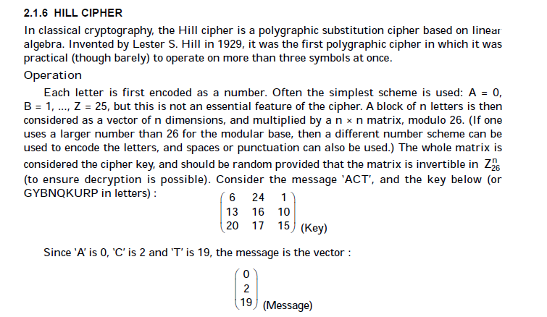

Slide 5
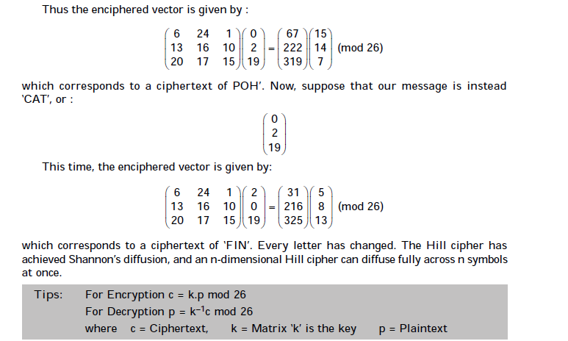

Slide 6
Examples: Hill Cipher
Input : Plaintext: GFG
Key: HILLMAGIC
Output : Ciphertext: SWK

